Slide 1
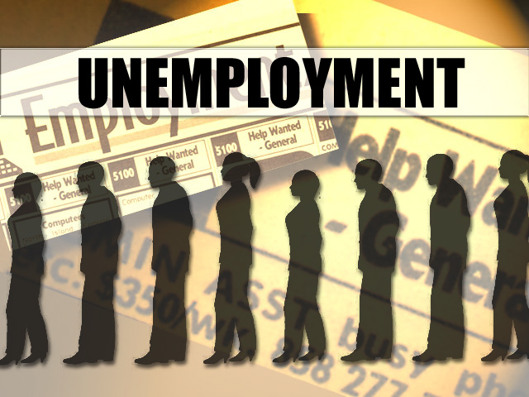
UNEMPLOYMENT
Chapter 11, Section 1

Slide 2
UNEMPLOYMENT RATE
The most closely watched and highly publicized labor force statistic
The percentage of people in the civilian labor force who are unemployed
Increases during recession
Decreases during expansion

Slide 3
DISCOURAGED WORKERS
People who want a job but have stopped looking for work for job related reasons.
Ben is 57 and worked as a computer programmer for 15 years. Faced unemployment for 1 year and now faces stiff job competition. He has quit looking for work but still wants a job.
“What’s the point?”

Slide 4
UNDEREMPLOYED
Unemployment does not indicate the number of underemployed workers.
Workers who have jobs beneath their skill level or who want full-time work but are only able to find part-time jobs.
EX: College graduate who is waiting tables

Slide 5
FULL EMPLOYMENT
Full employment does not mean that everyone has a job
SOME unemployment is healthy for the economy.
Economists generally consider an unemployment rate of about 5%--95% of the labor force is FULL EMPLOYMENT

Slide 6
TYPES OF UNEMPLOYMENT
Frictional Unemployment
Structural Unemployment
Seasonal Unemployment
Cyclical Unemployment

Slide 7
FRICTIONAL
When workers are moving from one job to another
People who have decided to leave one job to look for another
Includes new-entrants & re-entrants
Normal and Healthy
Reflects a workers freedom of choice

Slide 8
STRUCTURAL
Unemployment that occurs as a result of changes in technology or the way our economy is structured
Technological advances and shifts in consumer tastes

Slide 9
SEASONAL
Season to Season
As a result of regular occurrences, holidays, the school year, harvest, and industry production

Slide 10
CYCLICAL
Unemployment resulting from recessions and economic downturns
Harms the economy more than any other type of unemployment
Sales decline, producers tend to reduce output and lay off workers

Slide 11
Feb. 3, 2012 Unemployment Report

