Slide 1
Influences on the Business Cycle
Expansion/Recovery
Peak
Contraction/Recession
Trough

Slide 2
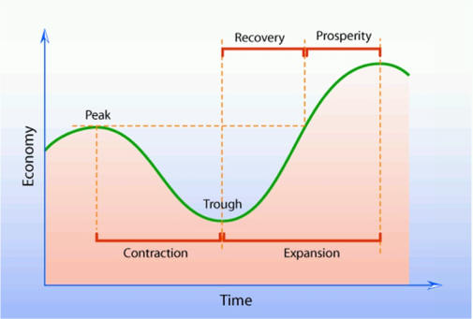
The factors that affect supply and demand also cause the fluctuations in the business cycle.

Slide 3
BUSINESS INVESTMENT
Businesses invest in capital goods –such as new machinery- to increase their production
High levels of business investment promote expansion in the business cycle.
Low levels of investment contribute to contractions.

Slide 4
BUSINESS INVESTMENT
By purchasing new capital goods, businesses create a demand for these goods.
Businesses use the new capital to moderate production methods and promote efficiency.
Increased business investment (particularly in the research and development) tends to stimulate technological change and generally results in higher output at lower productions costs.

Slide 5
MONEY & CREDIT
Many times, the amount of money in circulation depends mainly on government policies.
Individuals and businesses generally borrow more money to make purchases when interest rates are low.

Slide 6
PUBLIC EXPECTATIONS
Expectations about future economic conditions can shape current economic behavior as well.
If consumers believe that the economy is heading toward a recession, they may decide to limit their spending in order to save money for the hard times ahead.

Slide 7
EXTERNAL FACTORS
Changes in the world’s economic or political climate also affect the business cycle in the United States.
OIL PRICES
WAR

Slide 8
PREDICTING the BUSINESS CYCLE
Economists try to predict fluctuations in the business cycle.
Decision makers in business use these predictions of future economic activity to help plan for plant construction, expansion, or modernization, production goals, and hiring.

Slide 9
Leading Indicators Coincident Indicators Lagging Indicators
Economists often rely on three types of economic indicators to determine what phase of the business cycle the economy is currently in and in which direction it is heading….

Slide 10
LEADING INDICATORS
Anticipate the direction in which the economy is headed
Changes in the number of building permits issued, the number of orders for new capital and consumer goods, the price of raw materials, and stock prices.

Slide 11
COINCIDENT INDICATORS
Provide information about the current status of the economy.
COINCIDENT INDICATORS change as the economy moves from one phase of the business cycle to another
Tell economists that an upturn or a downturn in the economy has arrived
Personal Income, Sales Volume, Industrial Production Levels

Slide 12
LAGGING INDICATORS
Change months after an upturn or a downturn in the economy has begun
Help economists predict the duration of economic upturns or downturns
Use of consumer credit, the number and size of business incomes.

